Slide 1

Financial Analysis
EG32002
Group 7

Slide 2
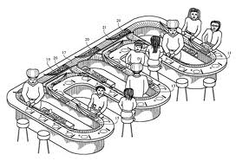
Initial Costs
Shop fitting
Administrative Costs
Initial Training
Hiring Process
Initial Stock

Slide 3
Sales Forecast
Business will consistently grow net profits based on:
Average Cost of Individual Sushi Dish £ 5.00
Average Cost of Bill Per Person £13.50
Number of Customers Per Week (Year 3) 1400
Variable costs will increase with demand and have been factored in calculations
 | Sales Forecast
Year | 1 | 2 | 3
Total Sales | £350,000.00 | £385,000.00 | £423,500.00
Start Up Costs | £90,000.00 | - | -
Operating Cost | £ 37,450.00 | £ 37,450.00 | £ 37,450.00
Variable Cost | £ 142,450.00 | £ 152,950.00 | £ 164,500.00
Advertising and Marketing | £ 5,000.00 | £ 5,000.00 | £ 5,000.00
Net Profit | £ 75,100.00 | £ 189,600.00 | £ 216,550.00

Slide 4

Profit Margin
The profitability of the company was taken into account
The profit margins for the first three years of trading are projected as:
Year 1 0.59
Year 2 0.60
Year 3 0.61
The capital invested in the company will therefore
result in strong profits and improve as time
goes on.

Slide 5
Break Even Analysis
The business will break even when the sales reach approximately £100k
This will occur within the last quarter of year 1
This will be a positive result for a restaurant.

